Slide 1
INTRODUCTION TO DATA ANALYTICS
FINAL PROJECT

Slide 2


TABLE OF CONTENTS
Introduction & Problem Statement
Data Source & Data Preparation
Data Analysis
Data Cleansing and Transformation
Separate Training and Test Data
Methodology
Modeling Naïve Bayes to Predict order Priority
Results Prediction & evaluation
Executive Summary
Major Challenges and solutions
Future work

Slide 3
INTRODUCTION AND PROBLEM STATEMENT
The project involves implementing data analytics lifecycle such as data preprocessing, unsupervised learning models to understand the data and the relationship between attributes and then apply classification models such as naive bayes and decision trees to predict the order priority attribute. After that we will also evaluate the accuracy of the model.
The dataset contains sales-order data of a Global E-commerce company. Global Super Store is a data set, It's a customer centric data set , which has the data of all the orders that have been placed through different vendors and markets , starting from the year 2011 till 2015.
The dataset has 51290 Rows / 24 Features (what each of the rows mean)

Slide 4
INTRODUCTION AND PROBLEM STATEMENT (CONTD.)
Following are the development platforms used during the Project :- 1) RStudio 2) Tableau
RStudio is an IDE (Integrated Software Environment) for R.
It provides a browser, syntax-highlighting editor that facilitates direct code execution, as well as plotting, history, debugging, and workspace management tools.
Tableau is a powerful and fastest-growing data visualization tool used in the business intelligence sector. It helps to simplify raw data in a format that is very easy to understand.
The data processing is very fast with Tableau and the resulting visualizations are in the form of dashboards and worksheets.

Slide 5
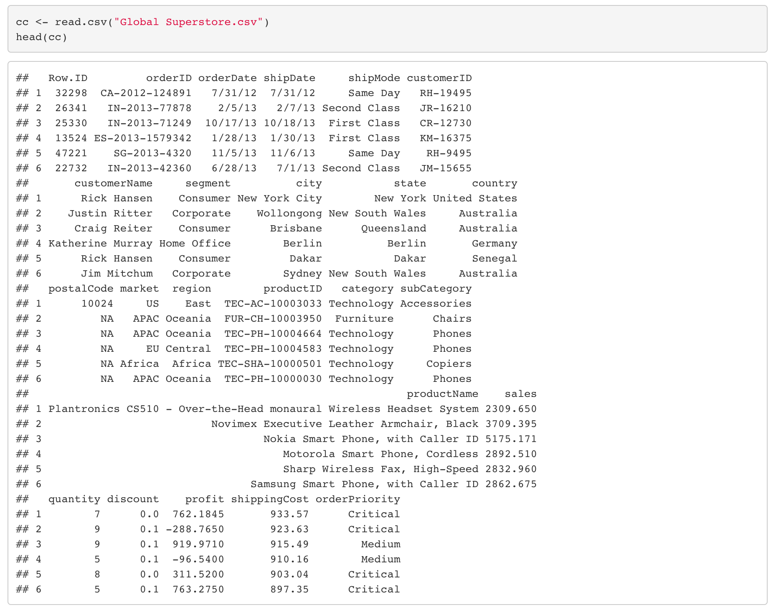
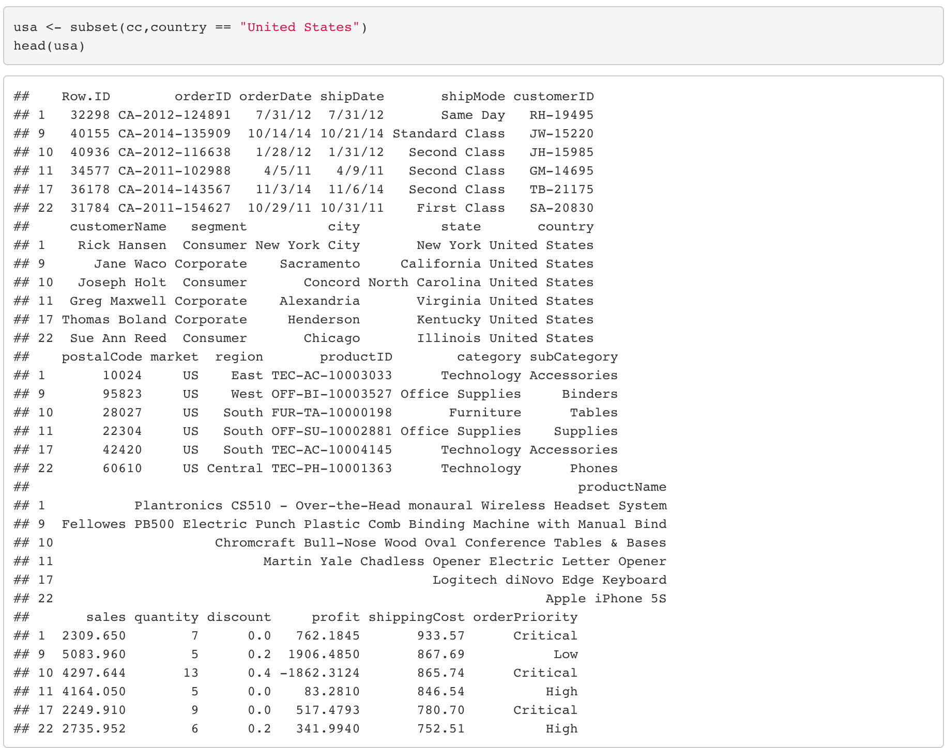
DATA SOURCE AND DATA PREPARATION
Original dataset
Only USA dataset
The Dataset was imported to R-Studio and originally
contained 51,290 rows of data for multiple countries
Using the subset method, the dataset was filtered
down to 9,994 rows containing only USA data

Slide 6
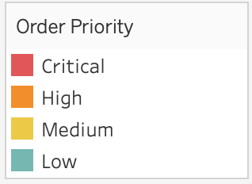
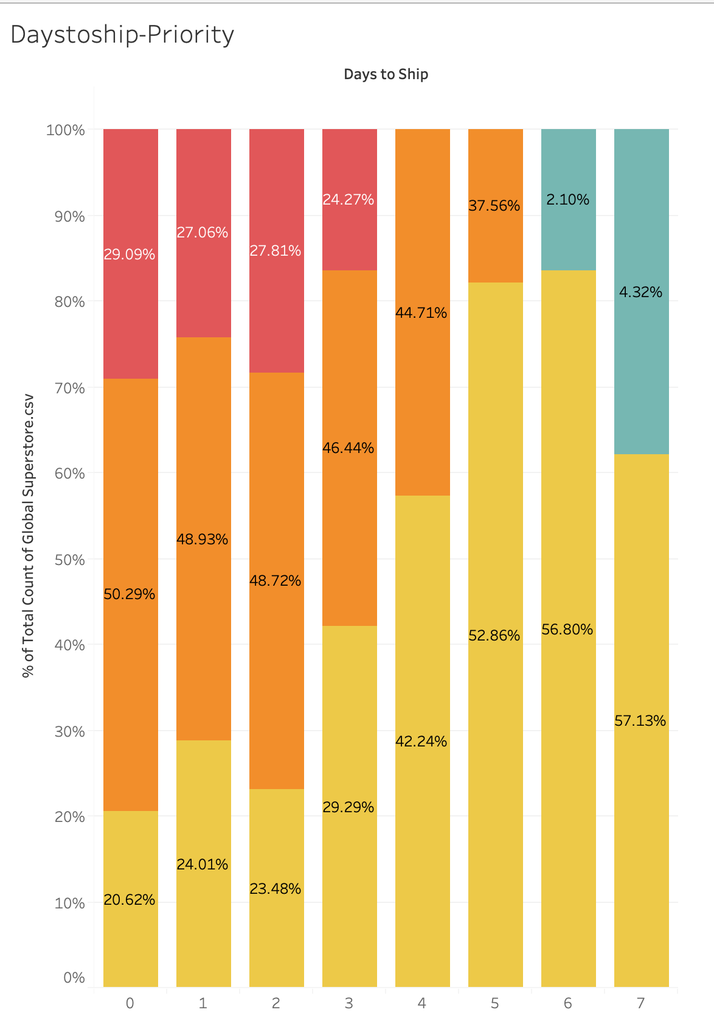
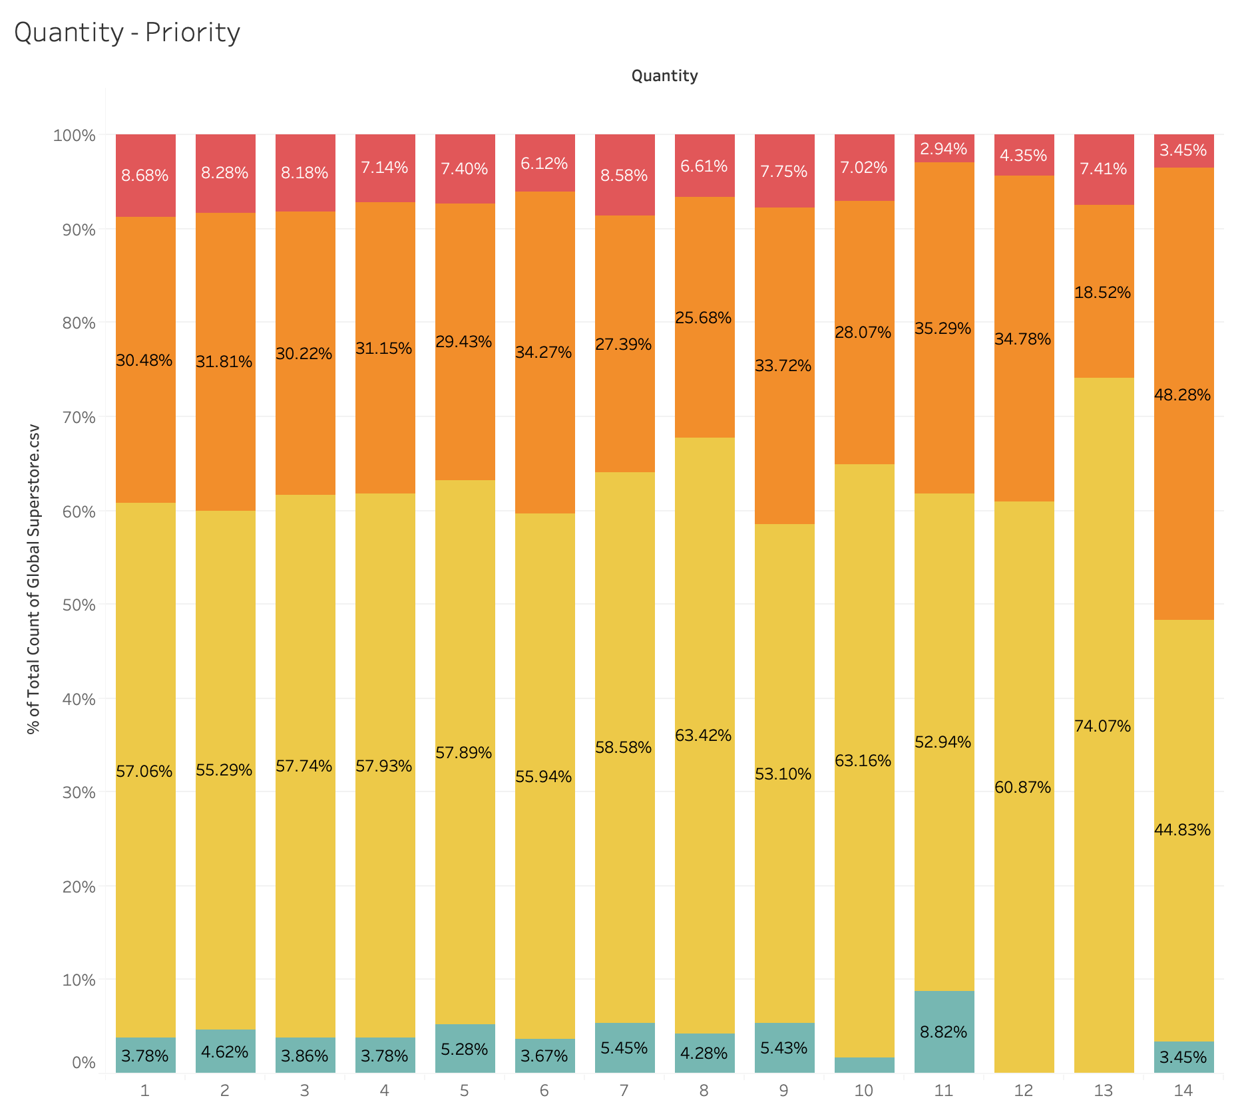
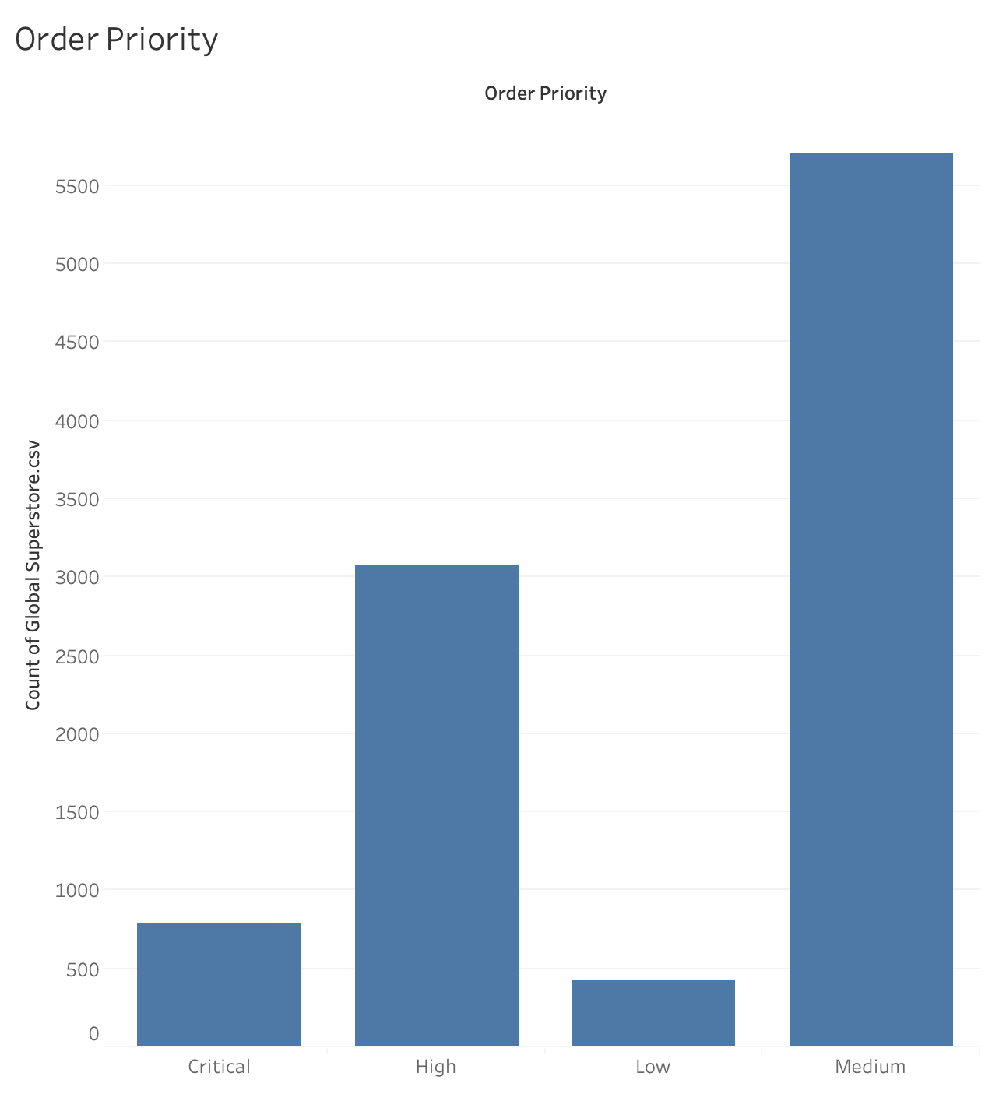
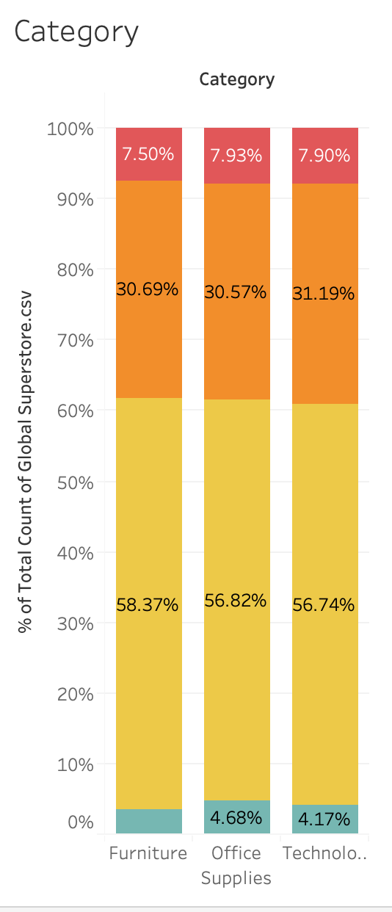
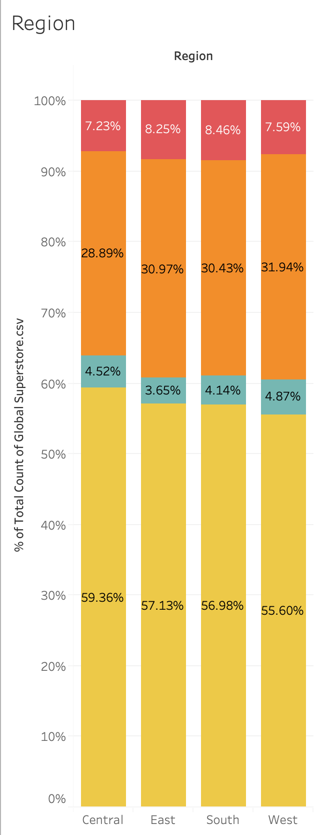
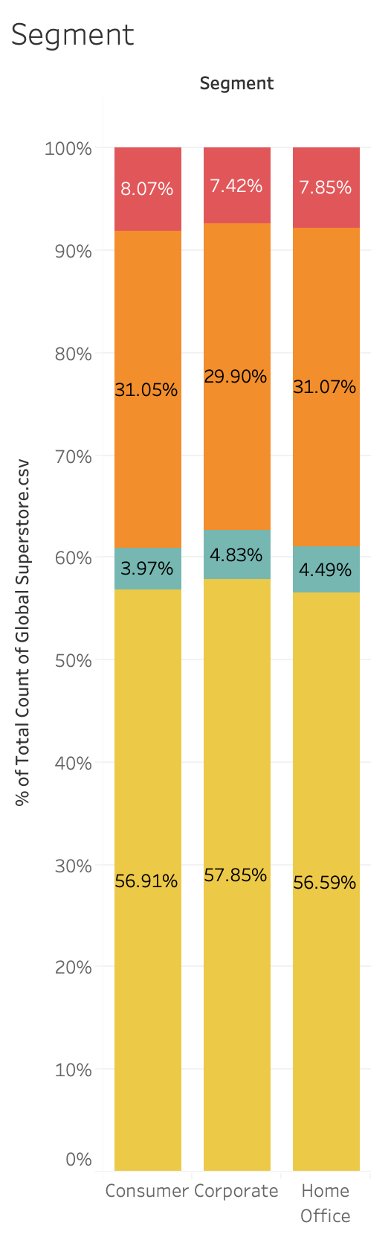
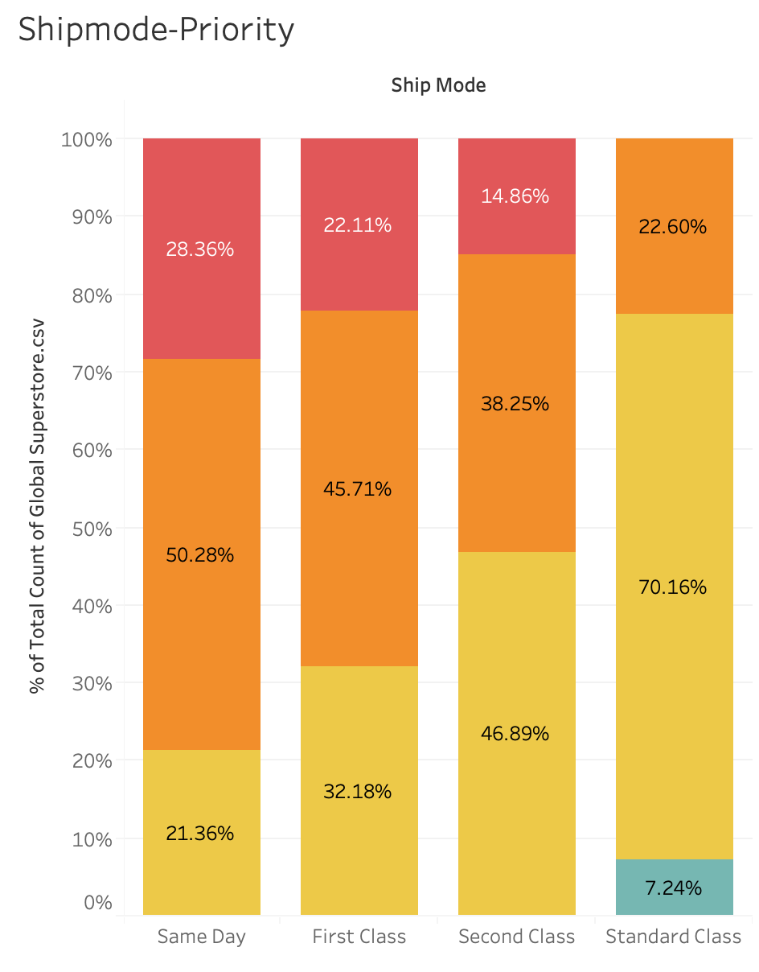
DATA ANALYSIS
The data was then visualized using Tableau to get a better
understanding of the correlation between order priority
and the relevant categorical fields.
Most of the date belonged to the medium priority criteria.
To remove the visual bias caused by the skewness, the data
is presented as percentage columns.
The following columns were
selected to predict order priority:
Days to Ship
Quantity
Ship Mode
Segment
Region
Category

Slide 7
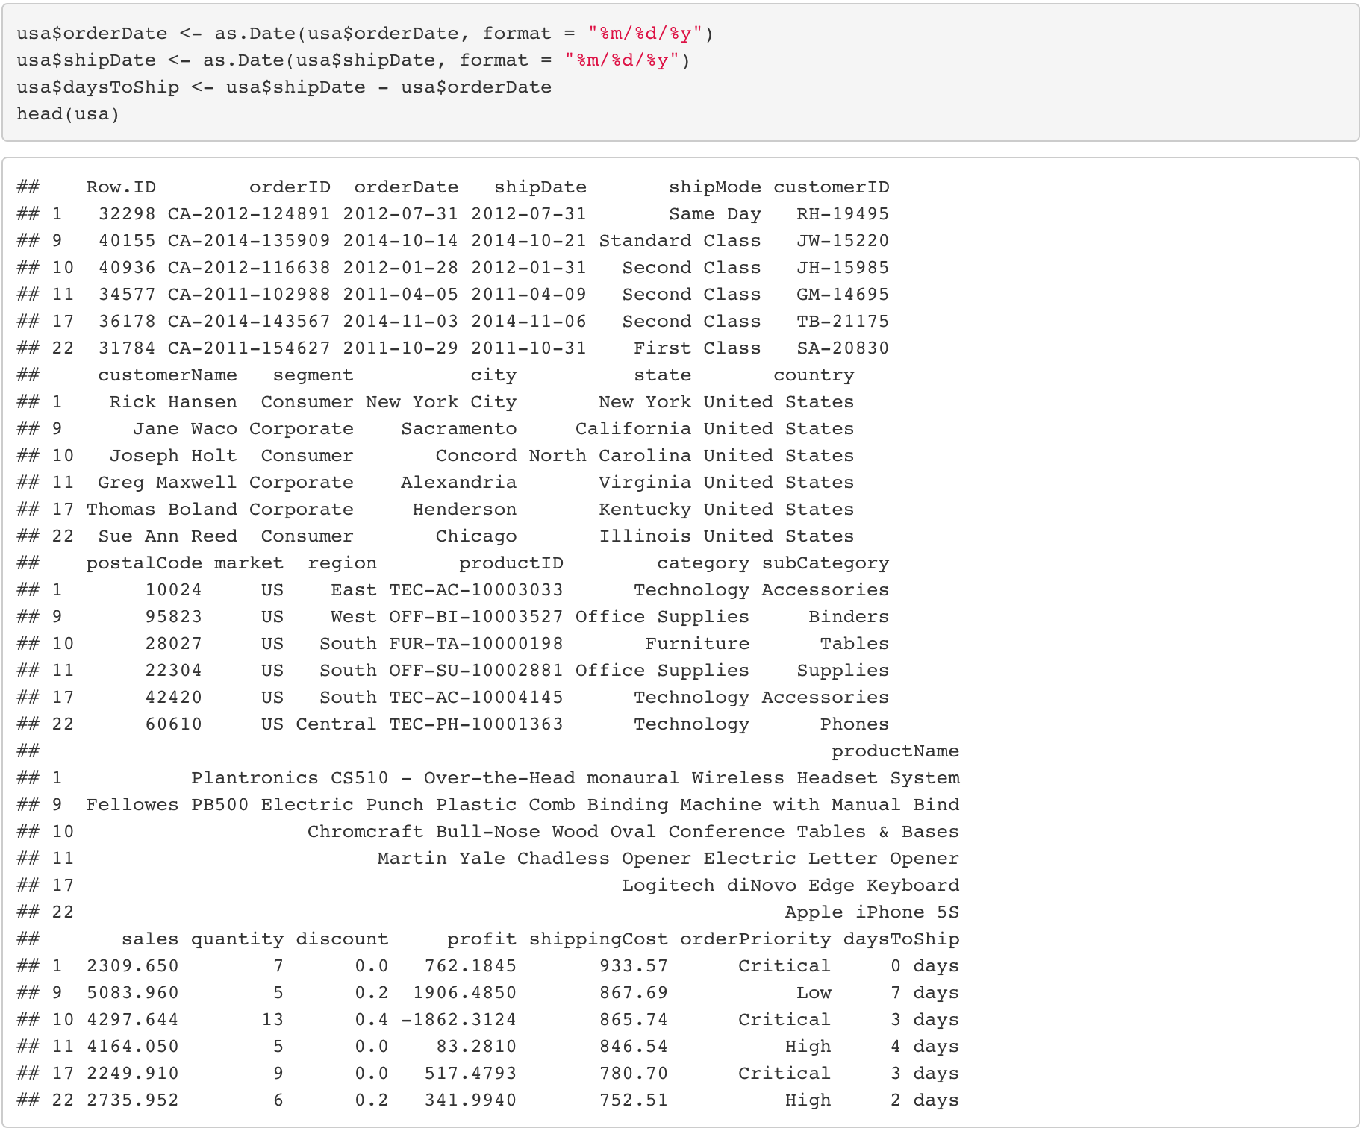
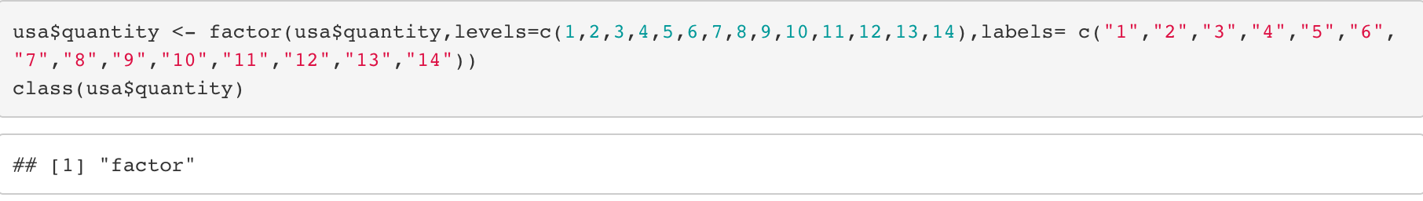
DATA CLEANSING AND TRANSFORMATION
The quantity field was converted from integer to factor in
order for the Naïve Bayes to perform conditional probability
The new variable daysToShip was created
by subtracting order date from ship date

Slide 8
SEPARATE TRAINING AND TEST DATA
The dataset is divided into training dataset and testing dataset
The two datasets — the training dataset and test dataset, are both essential datasets as they serve because they are used for different purposes.
The training dataset (also called the training set, learning set, or AI training data) is the initial dataset used to train an algorithm to understand how to
apply technologies such as neural networks, to learn and produce complex results.
The test dataset, however, is used to assess how well our algorithm was trained with the training dataset.

Slide 9
METHODOLOGY – DECISION TREES
To predict the order priority we have implemented Decision Tree and Naïve Bayes model.
Decision Trees :- The decision tree is a visual representation of all possible alternatives to a decision on the basis of such conditions. It's called a decision tree because it begins with a single box (or root) and then divides into a variety of solutions, much like a branch.
In Decision Trees each node represents a predictor variable (feature), the link between the nodes represents a Decision and each leaf node represents an outcome (response variable).
It is considered to be the most understandable Machine Learning algorithm and can be easily interpreted.
It can be used for problems with grouping and regression.
Unlike most Machine Learning algorithms, it works efficiently with non-linear data.
Building a Decision Tree is a very quick process, since it uses only one feature per node to split the data.

Slide 10

METHODOLOGY - NAÏVE BAYES
Naïve bayes Algorithm :- Naive Bayes is a probabilistic machine learning model used as a classifier. This falls under Supervised Learning Algorithms.
The term naive is used as it means that the functions of the model are independent of each other. This is changing the value of one feature, which does not directly influence or change the value of any of the other features used in the algorithm.
The intuition behind this algorithm is the theorem of Bayes. Bayes Theorem tells the probability of an event occurring, given the probability of another event that has already occurred.
The naive classifiers of Bayes assume that the value of a particular feature is independent of the value of any other feature given the class variable.

Slide 11
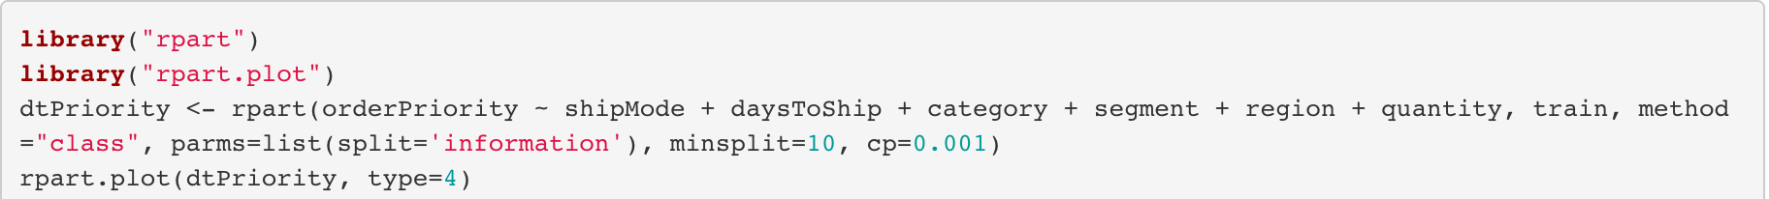
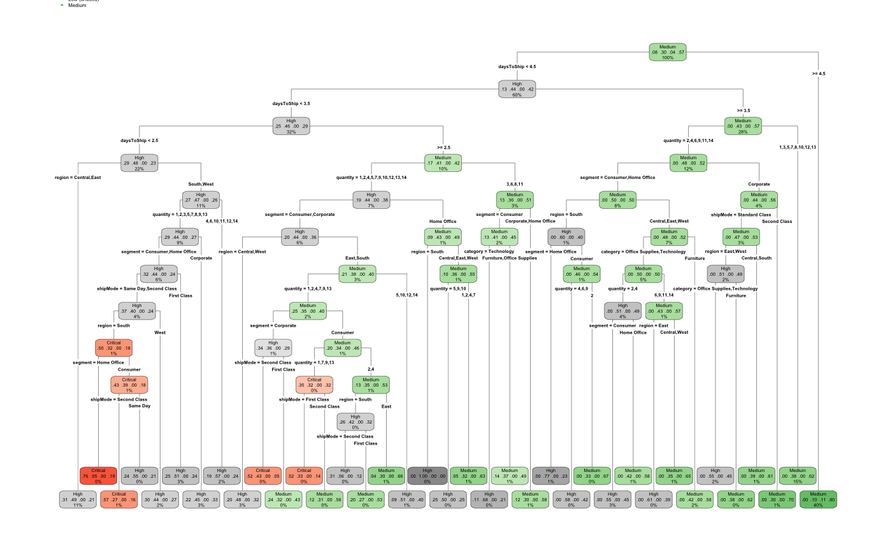
MODELING DECISION TREE TO PREDICT ORDER PRIORITY
The decision tree illustrates
the order priority based on
number of days to ship the
order. If the number of days
to ship the order is greater than
or equal to 4.5, the order
priority will be medium and if
days to ship is less than 4.5,
the order priority will be high
and furthermore, if the days to
ship is less than 3.5, the order
priority will remain high.
Therefore, the decision tree is
modeled based on number of
days to ship the order so that
the store can prioritize its order.

Slide 12
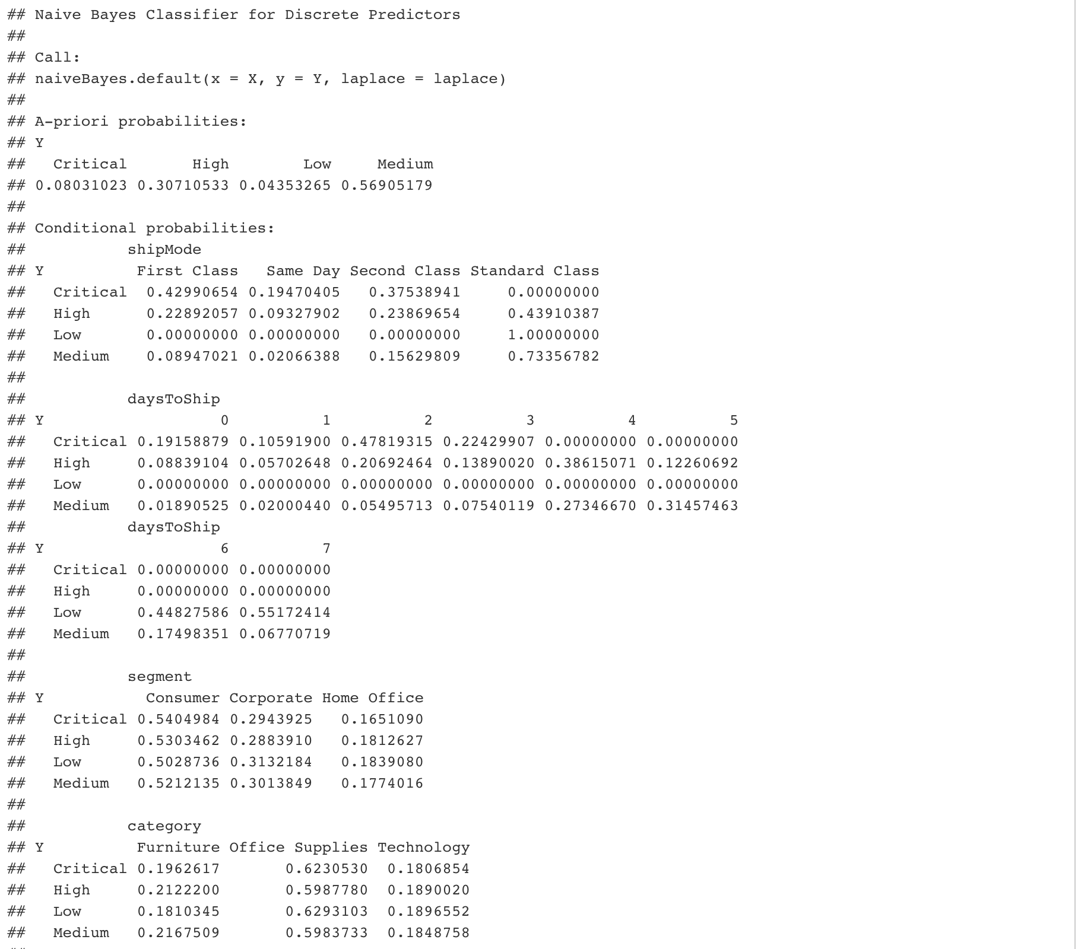
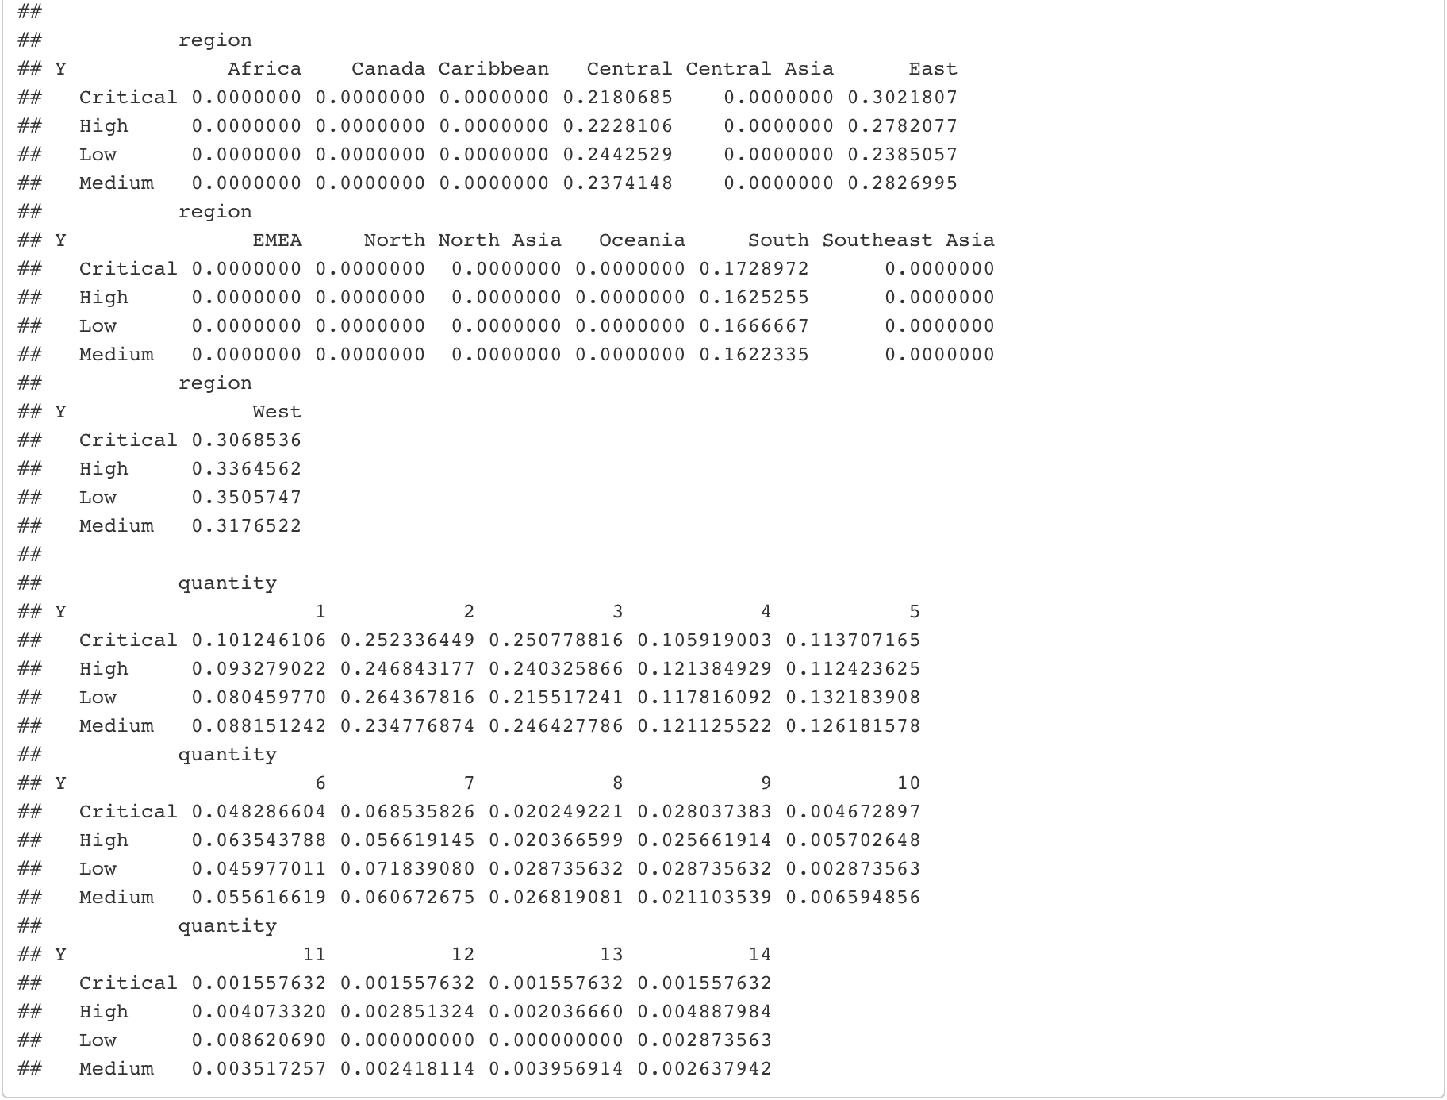
MODELING NAÏVE BAYES TO PREDICT ORDER PRIORITY
The Naïve Bayes shows the effect of different
factors such as ship mode, days to ship, segment,
category and quantity on order priority of the store.
If the ship mode is first class, it has higher chances
of getting critical order priority. If the ship mode is
standard class, it can be categorized in the low
order priority. Also, the conditional probability
shows that if the number of shipping days is high,
the order priority will be low which resembles to
our results from the decision tree.

Slide 13
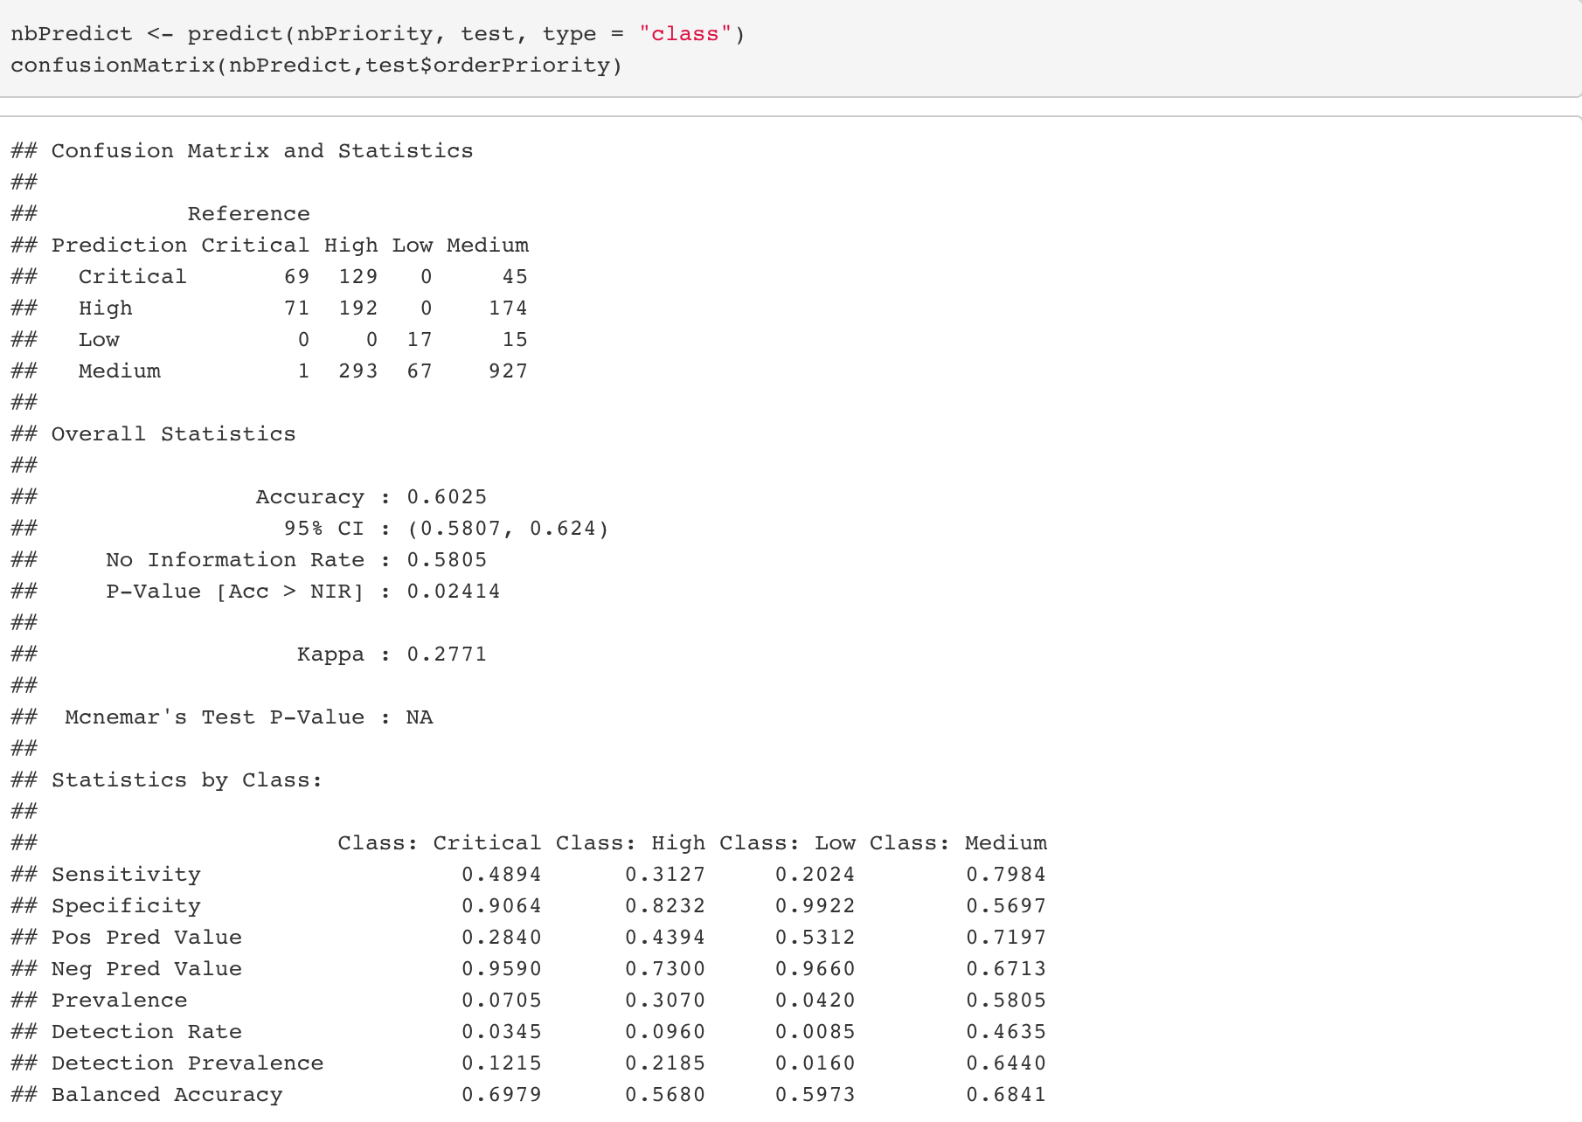
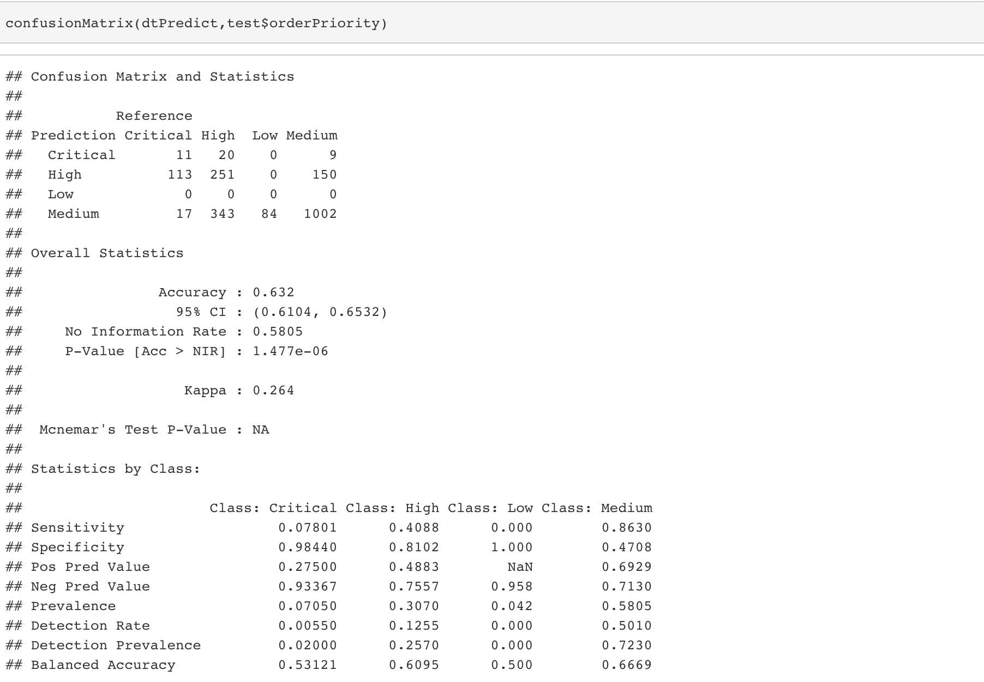
RESULTS (PREDICTION) AND EVALUATION
Decision Tree
Naïve Bayes
Accuracy : 0.6222
95% CI : (0.6005, 0.6435)
No Information Rate : 0.5675
P-Value [Acc > NIR] : 4.021e-07
Kappa : 0.2786
Accuracy : 0.5855
95% CI : (0.5636, 0.6073)
No Information Rate : 0.5675
P-Value [Acc > NIR] : 0.05405
Kappa : 0.2665

Slide 14
EXECUTIVE SUMMARY
In this project, we have implemented data analytics lifecycle, such as data pre-processing and un-supervised learning model to get better insights of the data and visualized the data by using Tableau to get profound understanding of the co-relation between order priority and other different fields of the dataset. We applied classification models such as Decision Tree and Naïve Bayes to predict the order priority of the store. In addition, we have plotted the ROC curve to calculate the performance of our model. After evaluating both the models to predict the order priority, the accuracy that we got is 88% which shows that all the factors like ship mode, days to ship, segment, category and quantity have a big impact on the order priority in order to evaluate and analyze our classification model. Also, the accuracy prediction of our model will help the store in prioritizing its orders to get better in business.

Slide 15
MAJOR CHALLENGES AND SOLUTIONS
One of the main challenges was to decide which fields to use for the prediction. The dataset had other fields such as city, region, sales and profit. How do we know that those fields do not contribute to deciding whether an order should be high or low priority? The solution to this problem was to visualize their relationship in Tableau and choose only the column that showed some co-relationship. But when working with datasets with more features it might be better to use clustering to find correlations.
Another challenge with the dataset was that dataset contained values from other countries as well so we had to take a subset of the dataset to the location of USA so that we that prediction with the order priority is more relevant and accurate.
Addittionally, choosing the ratio for dividing the dataset into training and testing. We took more percent of the data into training set so that as there are more rows in the training dataset the testing is more accurate
Finally which models to choose for prediction was the challenge face by our team as the order priority required classification as what is the priority of the order placed we choose to implement Naïve Bayes algorithm and Decision Tree as it performs well in the case of categorical input variables

Slide 16
FUTURE WORK
In future we using the model we can also analyze the other relevant attributes and forecast what will be the order priority in a particular season
For example if we have a christmas or a thanksgiving coming most of the orders can be of critical priority and based on the combined analysis the store can make prior arrangements to such orders where it can meet the demand and the time schedule according to which the customers wants the order
Also we can further research on different algorithms and analyze and devise a way to achieve better accuraccy for the model
Lastly, if the there are more dataset rows and attributes to show that whether the order priority was successfully meet in the revelant subset then we can also predict in future which particular products have not delivered the orders in the priority

